Slide 1
What the heck happened?
QA Tools – Squish & Test Center Thomas Piekarski Booth 21
STAREAST, Orlando, Wednesday, 27 April 2022

Slide 2

Agenda
1
Introduction
2
Live Demo
3
QA Tools
4
Wrap-up
5
Q&A

Slide 3

Introduction
All your tests have run successfully…

Slide 4

Introduction
All your tests have run successfully…
…and suddenly one test is failing…

Slide 5

Introduction
All your tests have run successfully…
…and suddenly one test is failing…
…what the heck happened?

Slide 6
Approaching failed tests
introduction
Verification message(s)

Slide 7
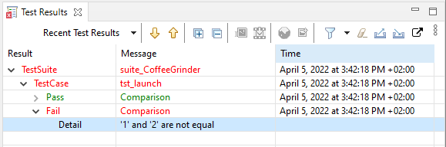
Approaching failed tests
introduction

Slide 8
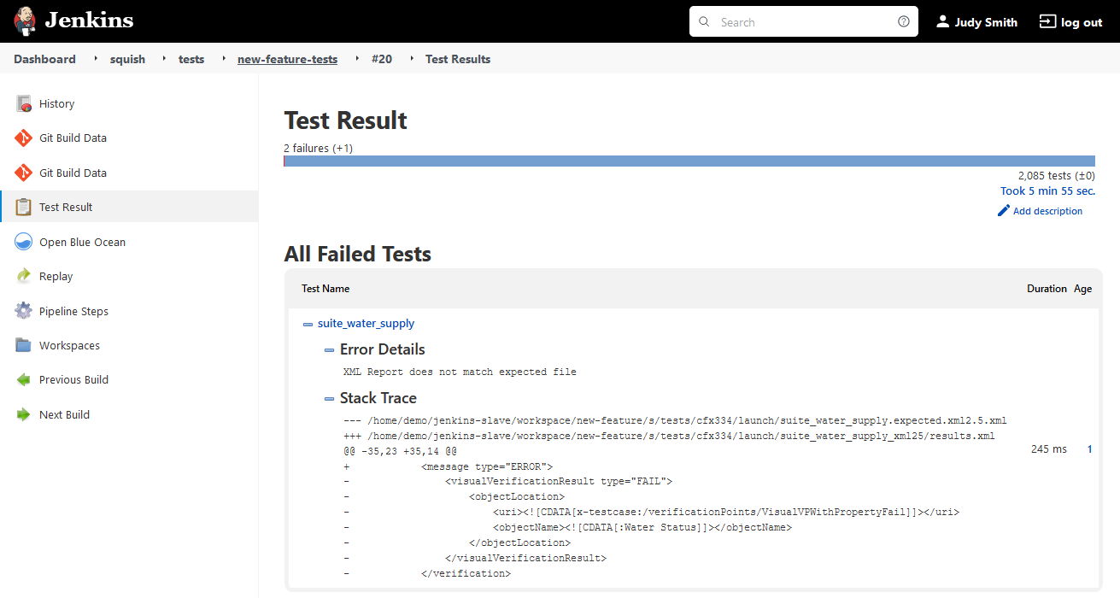
Approaching failed tests
introduction

Slide 9
Approaching failed tests
introduction
Verification message(s)
Logs and output of stdout/stderr

Slide 10
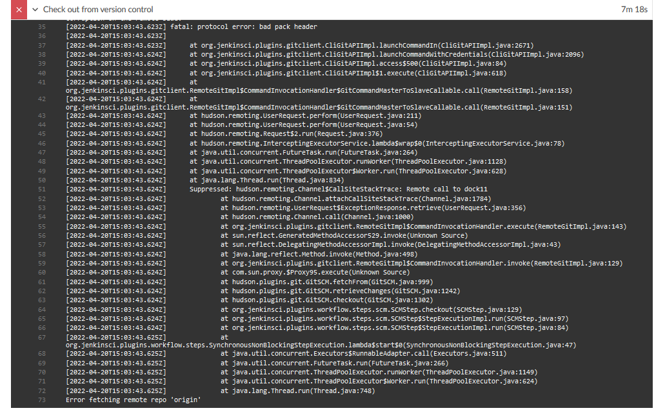
Approaching failed tests
introduction

Slide 11
Approaching failed tests
introduction
Verification message(s)
Logs and output of stdout/stderr
Call stacks, requests and responses

Slide 12
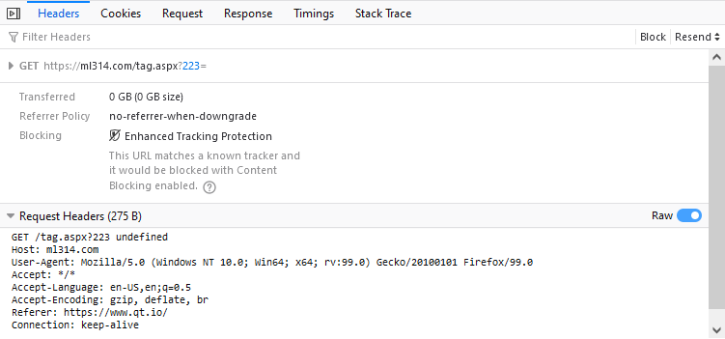
Approaching failed tests
introduction

Slide 13
Approaching failed tests
introduction
Verification message(s)
Logs and output of stdout/stderr
Call stacks, requests and responses
Version Control History

Slide 14
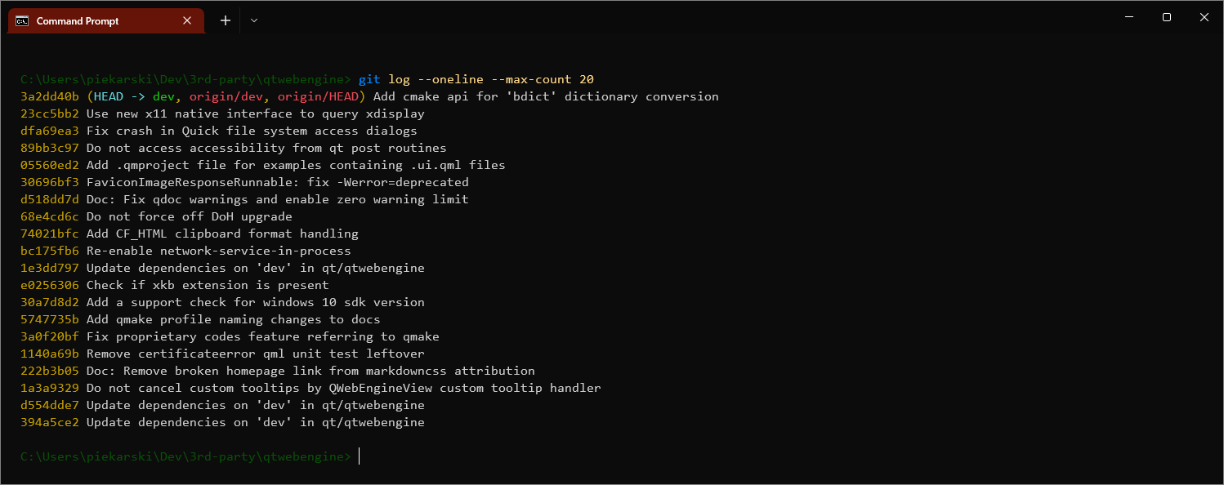
Approaching failed tests
introduction

Slide 15
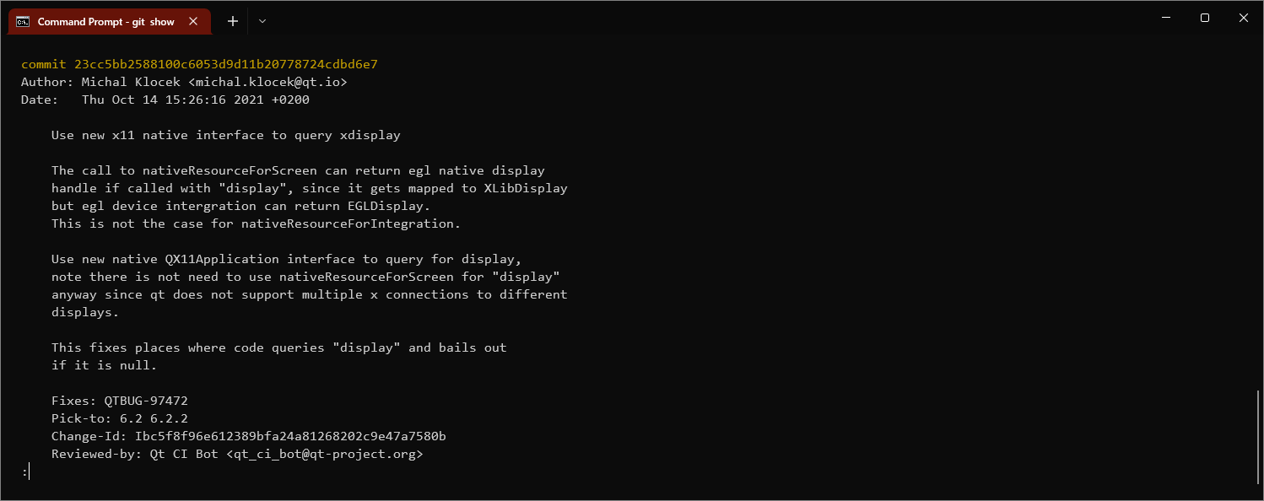
Approaching failed tests
introduction

Slide 16
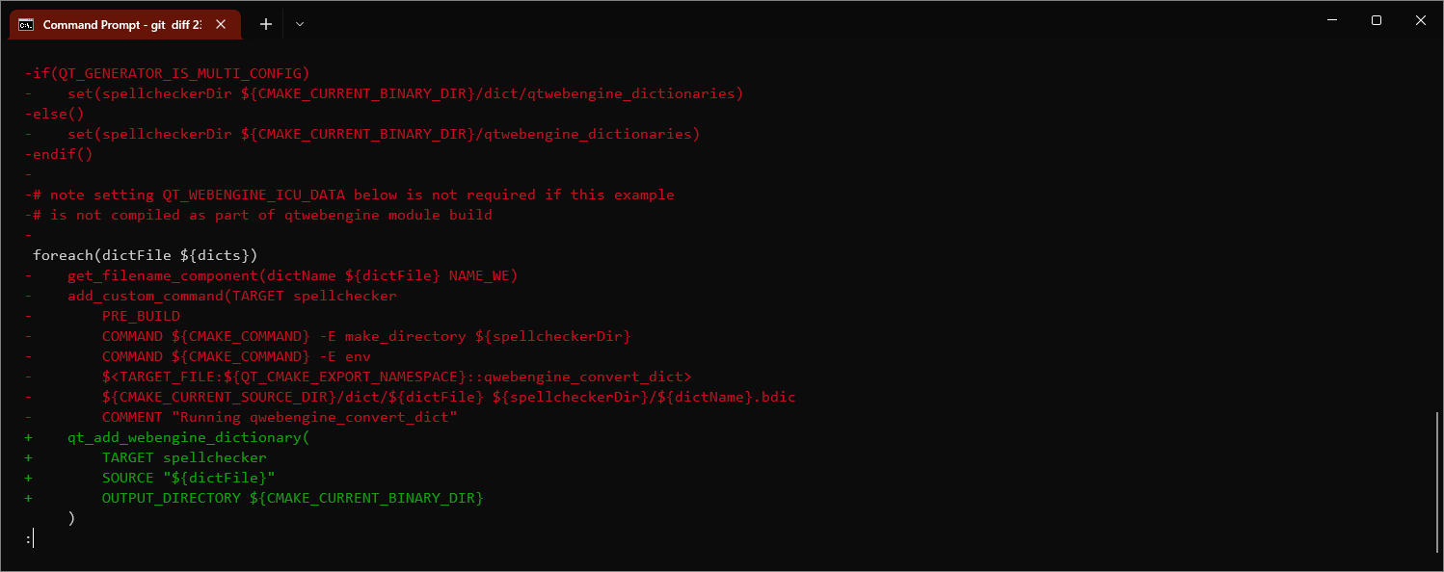
Approaching failed tests
introduction

Slide 17
Approaching failed tests
introduction
Verification message(s)
Logs and output of stdout/stderr
Call stacks, requests and responses
Version Control History
Scattering print statements

Slide 18
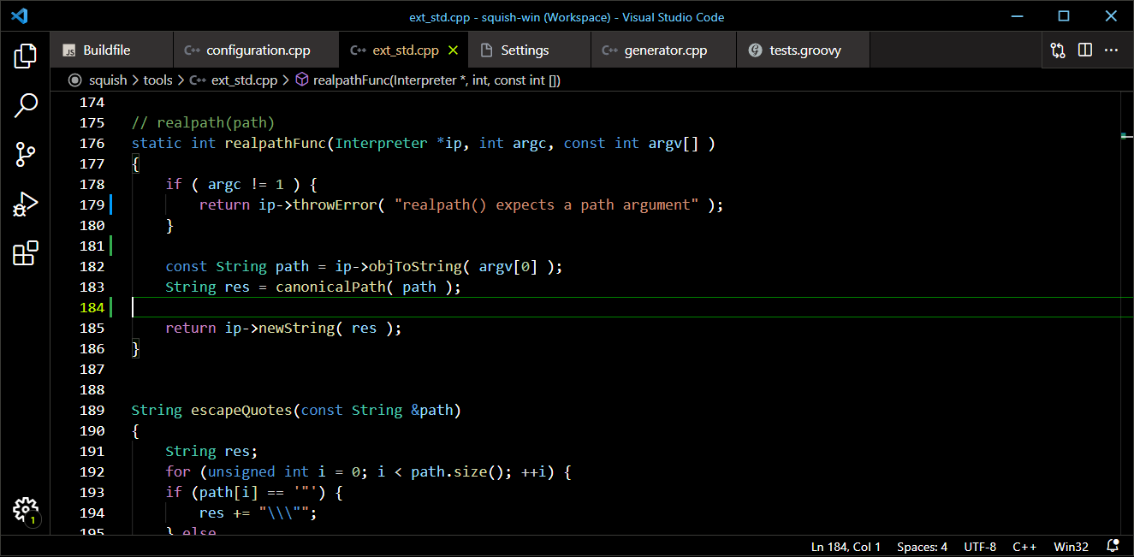
Approaching failed tests
introduction

Slide 19
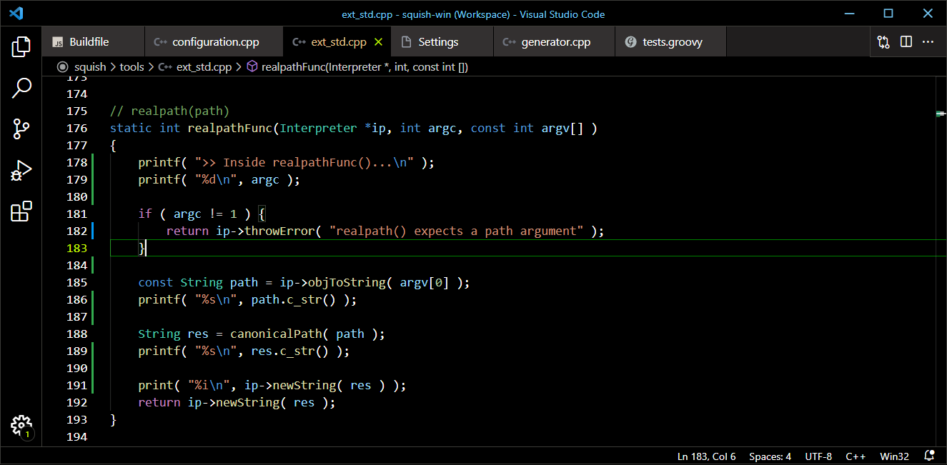
Approaching failed tests
introduction

Slide 20
Approaching failed tests
introduction
Verification message(s)
Logs and output of stdout/stderr
Call stacks, requests and responses
Version Control History
Scattering print statements
Stepping with a debugger

Slide 21
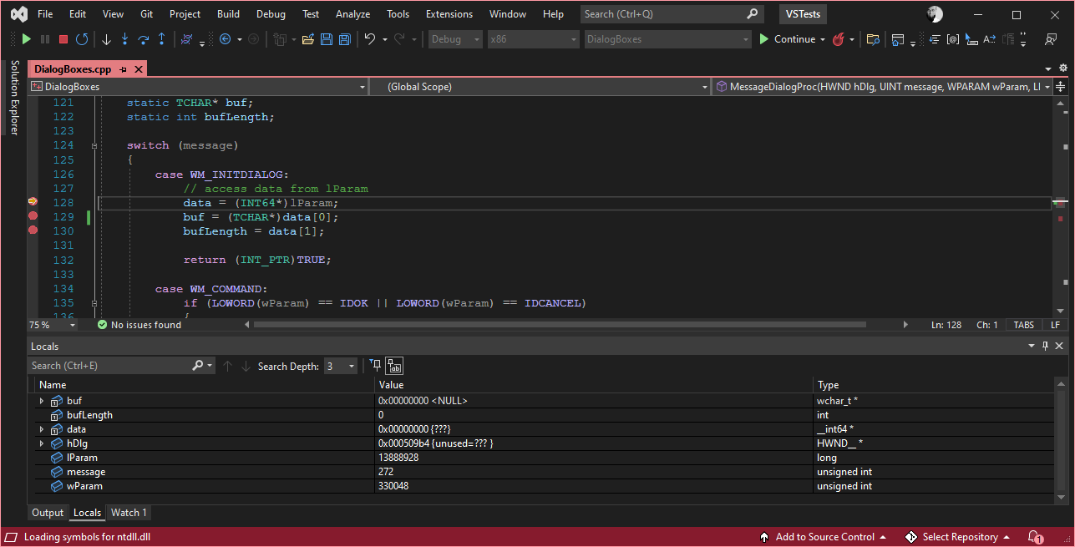
Approaching failed tests
introduction

Slide 22
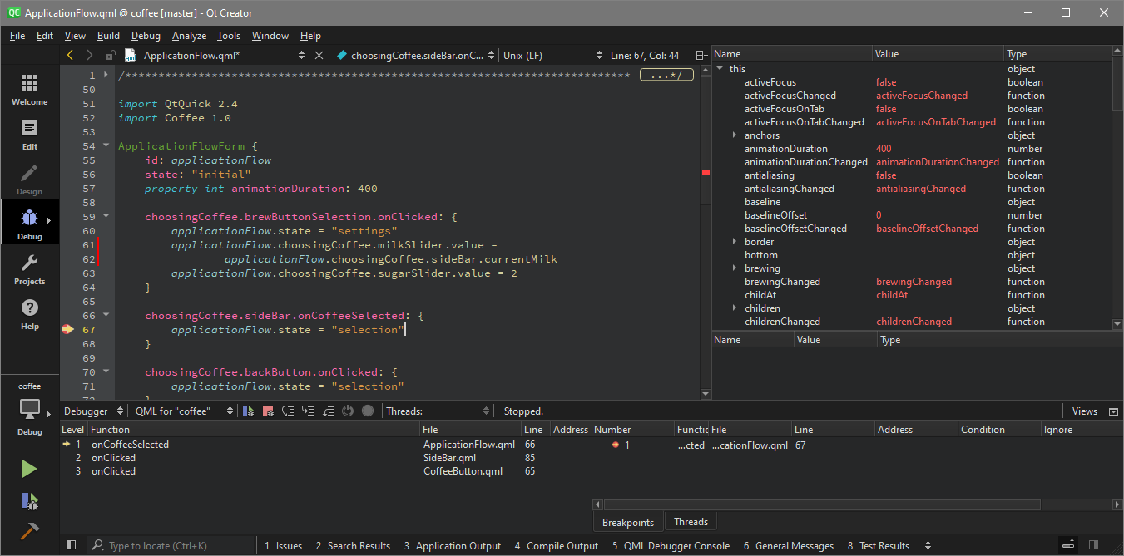
Approaching failed tests
introduction

Slide 23
Approaching failed tests
introduction
Verification message(s)
Logs and output of stdout/stderr
Call stacks, requests and responses
Version Control History
Scattering print statements
Stepping with a debugger
Screenshots

Slide 24
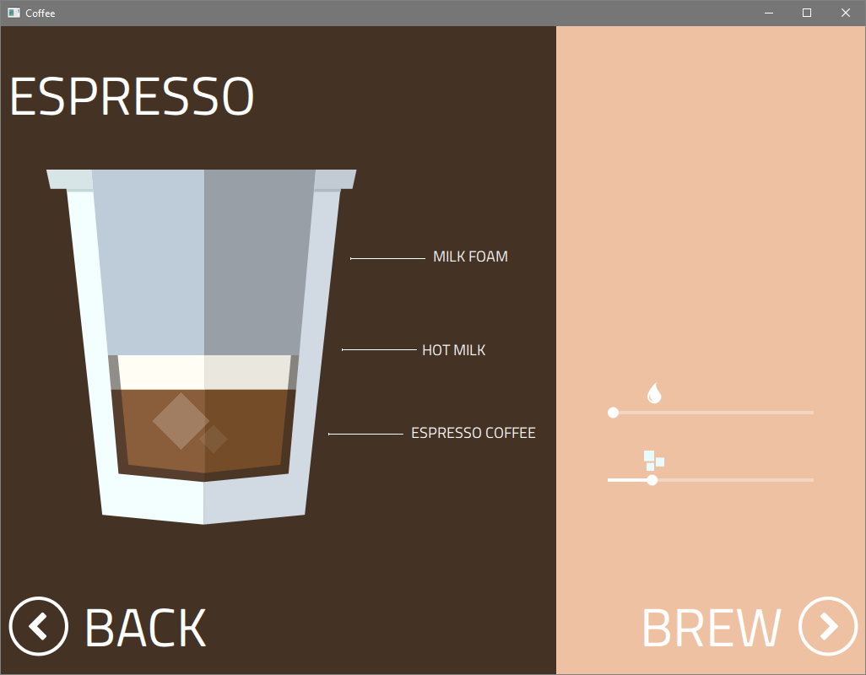
Approaching failed tests
introduction

Slide 25
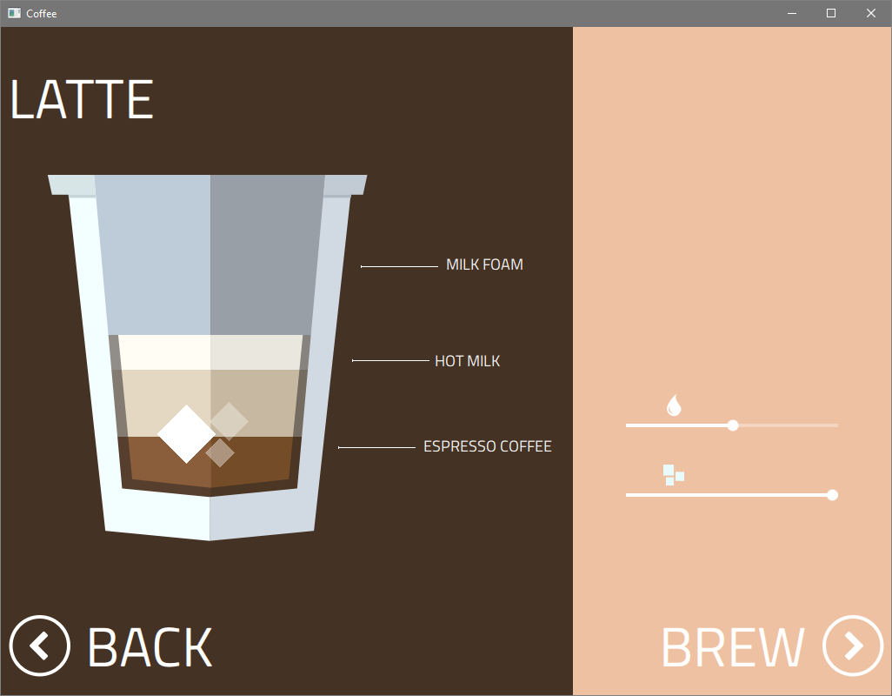
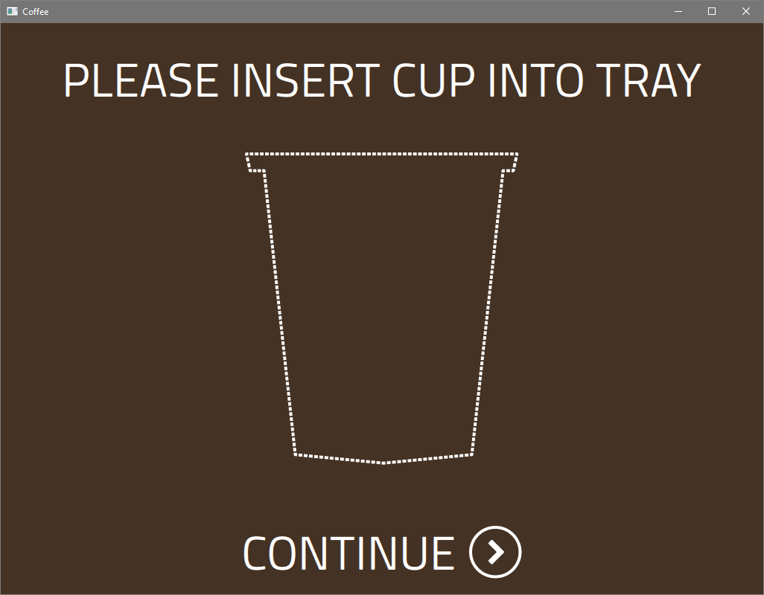
Approaching failed tests
introduction

Slide 26
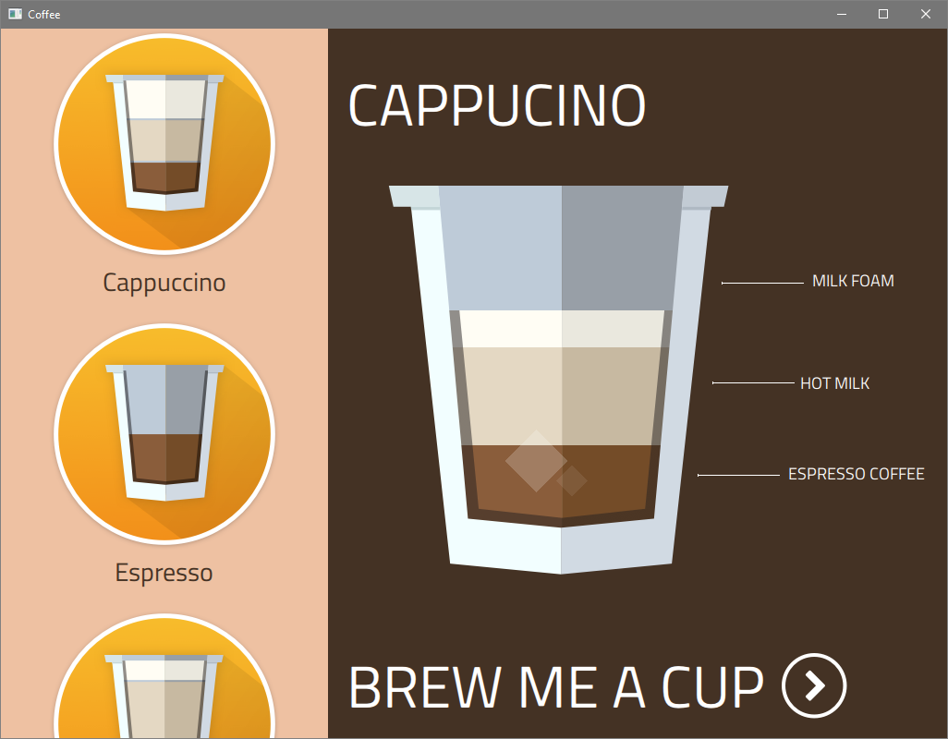
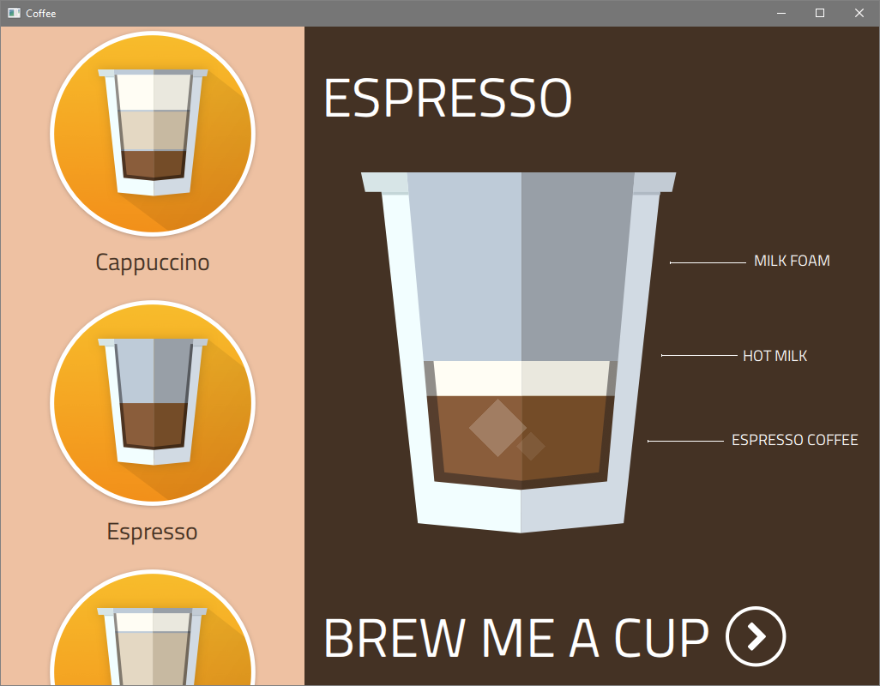
Approaching failed tests
introduction

Slide 27
Approaching failed tests
introduction
Verification message(s)
Logs and output of stdout/stderr
Call stacks, requests and responses
Version Control History
Scattering print statements
Stepping with a debugger
Screenshots
Google…

Slide 28
Approaching failed tests
introduction
Verification message(s)
Logs and output of stdout/stderr
Call stacks, requests and responses
Version Control History
Scattering print statements
Stepping with a debugger
Screenshots
Google…
…and of course, your colleague next door!

Slide 29
Approaching failed tests
introduction
Verification message(s)
Logs and output of stdout/stderr
Call stacks, requests and responses
Version Control History
Scattering print statements
Stepping with a debugger
Screenshots
Google…
…and of course, your colleague next door!
Is this enough to pinpoint a failure?

Slide 30
A picture is worth
a thousand words.

Slide 31
Approaching failed tests
Introduction
Video captured during test runs

Slide 32
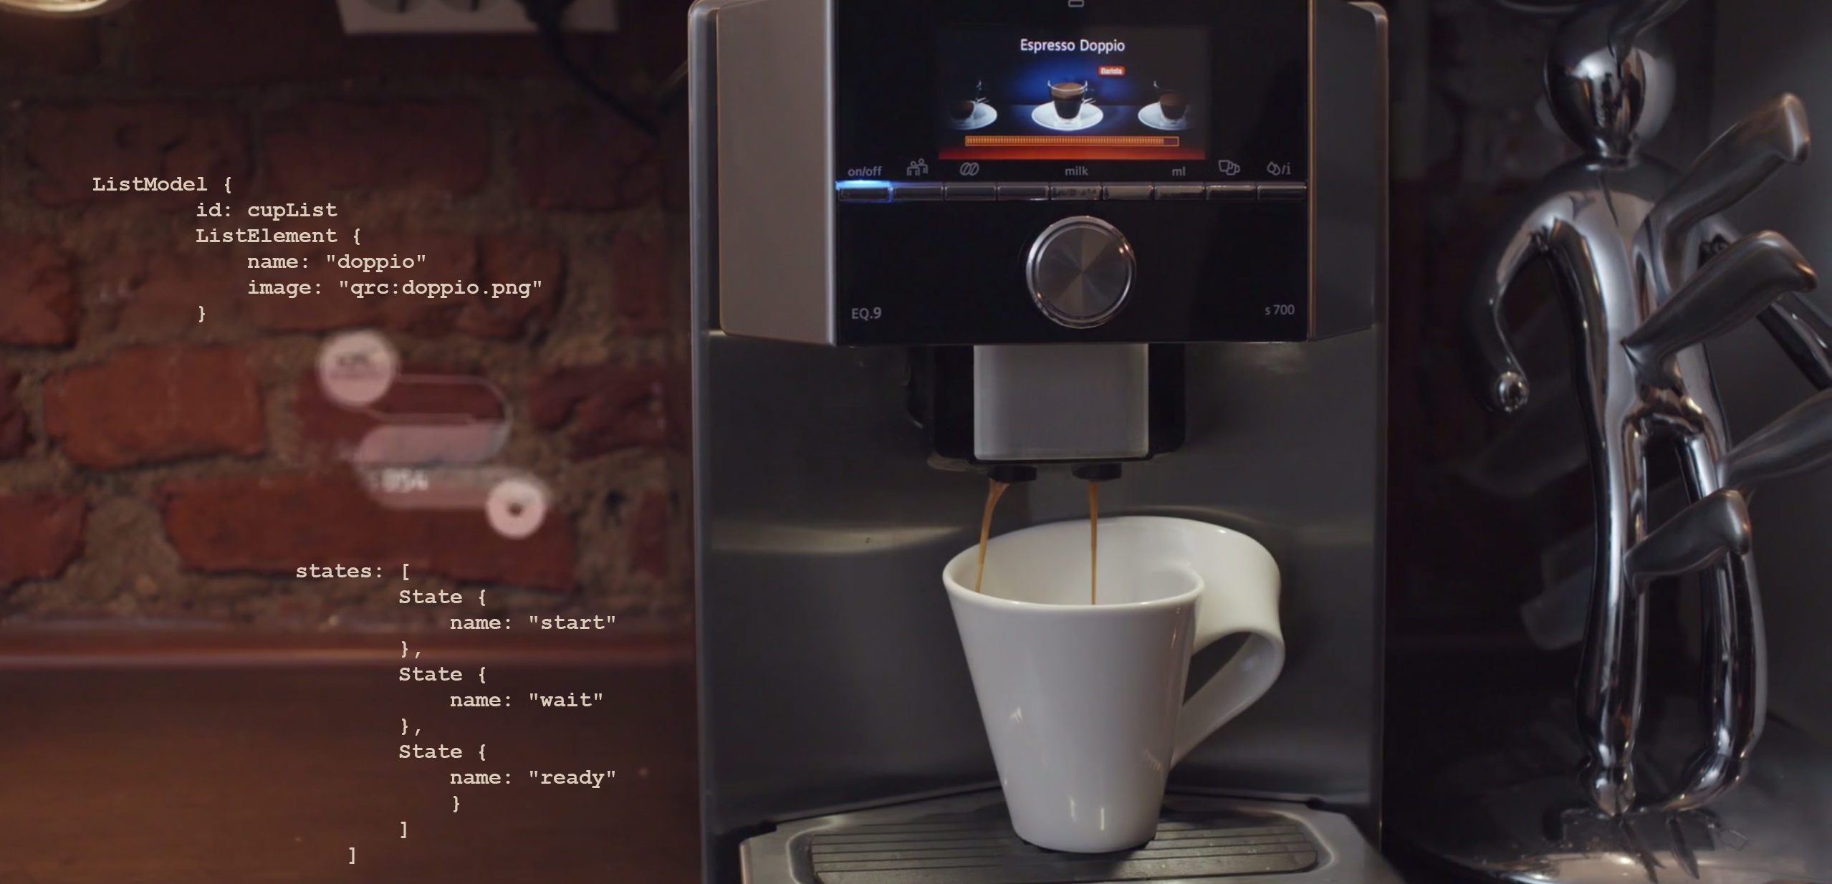
2
Live Demo – Testing a Coffee Machine

Slide 33
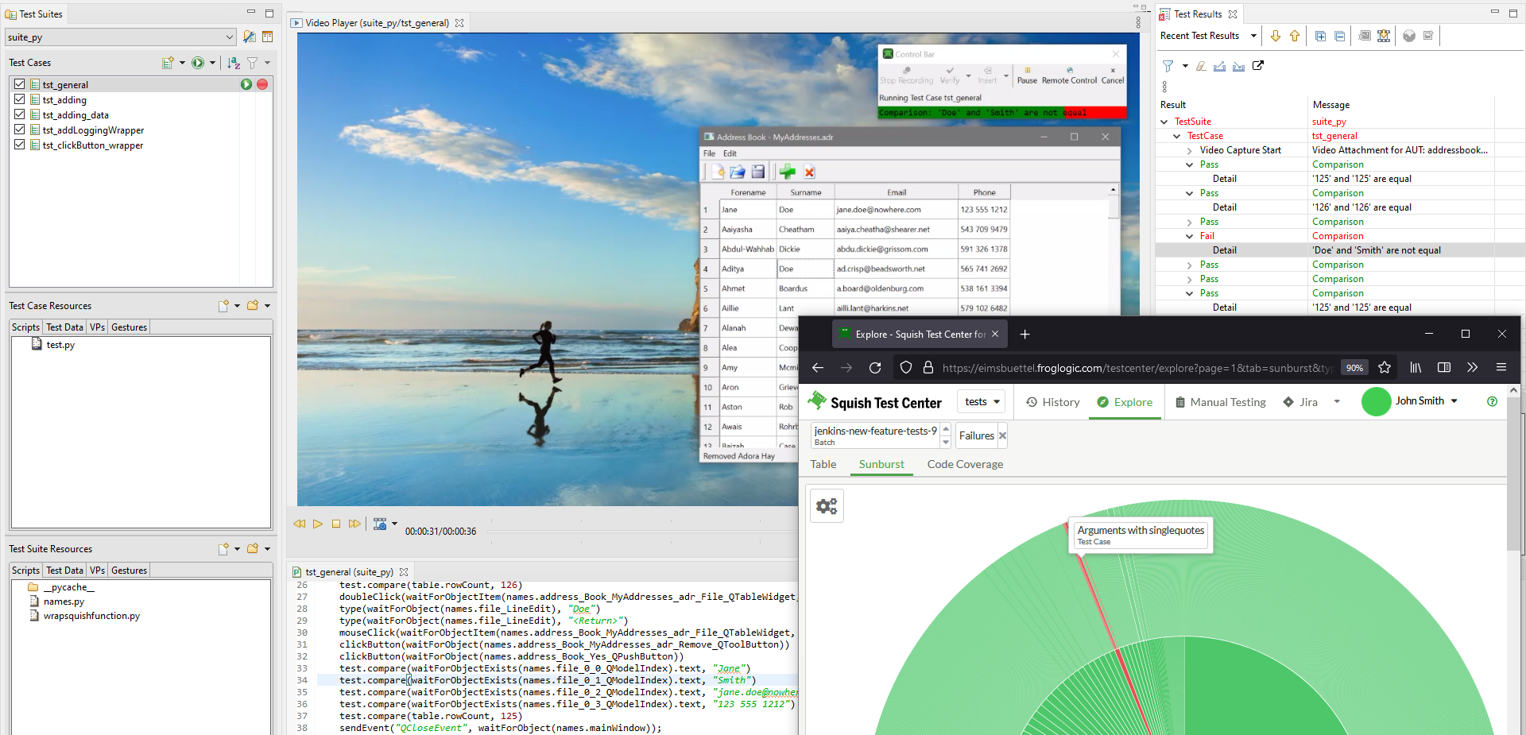
3
QA Tools

Slide 34

QA Tools
Squish
Multi-platform, object-aware automated GUI testing for virtually any toolkit

Slide 35

QA Tools
Squish
Multi-platform, object-aware automated GUI testing for virtually any toolkit
Coco
Cross-platform, cross-compiler advanced code coverage analysis & Tool Qualification

Slide 36

QA Tools
Squish
Multi-platform, object-aware automated GUI testing for virtually any toolkit
Coco
Cross-platform, cross-compiler advanced code coverage analysis & Tool Qualification
Test Center
Centralized test result management platform connecting automation with the entire dev process

Slide 37
QA Tools
Squish
Coco
Test Center
Notes:
…this session will focus on Squish (GUI Tester) and Test Center…

Slide 38
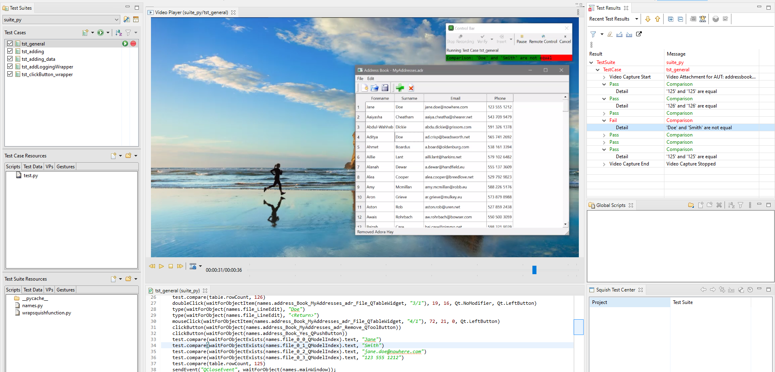
3.1
Overview of Squish GUI Tester
Notes:
Todo: add screenshot of Squish IDE / Squish Runner Output

Slide 39

Squish Quick Features
QA Tools
1
Recording and Replaying of Tests
2
Script- and BDD-based Test Development
3
Object-, Image- and OCR-driven

Slide 40
Squish Quick Features
QA Tools
4
Test across platforms and devices
5
Powerful IDE and Integration in CI
6
Video Capture

Slide 41
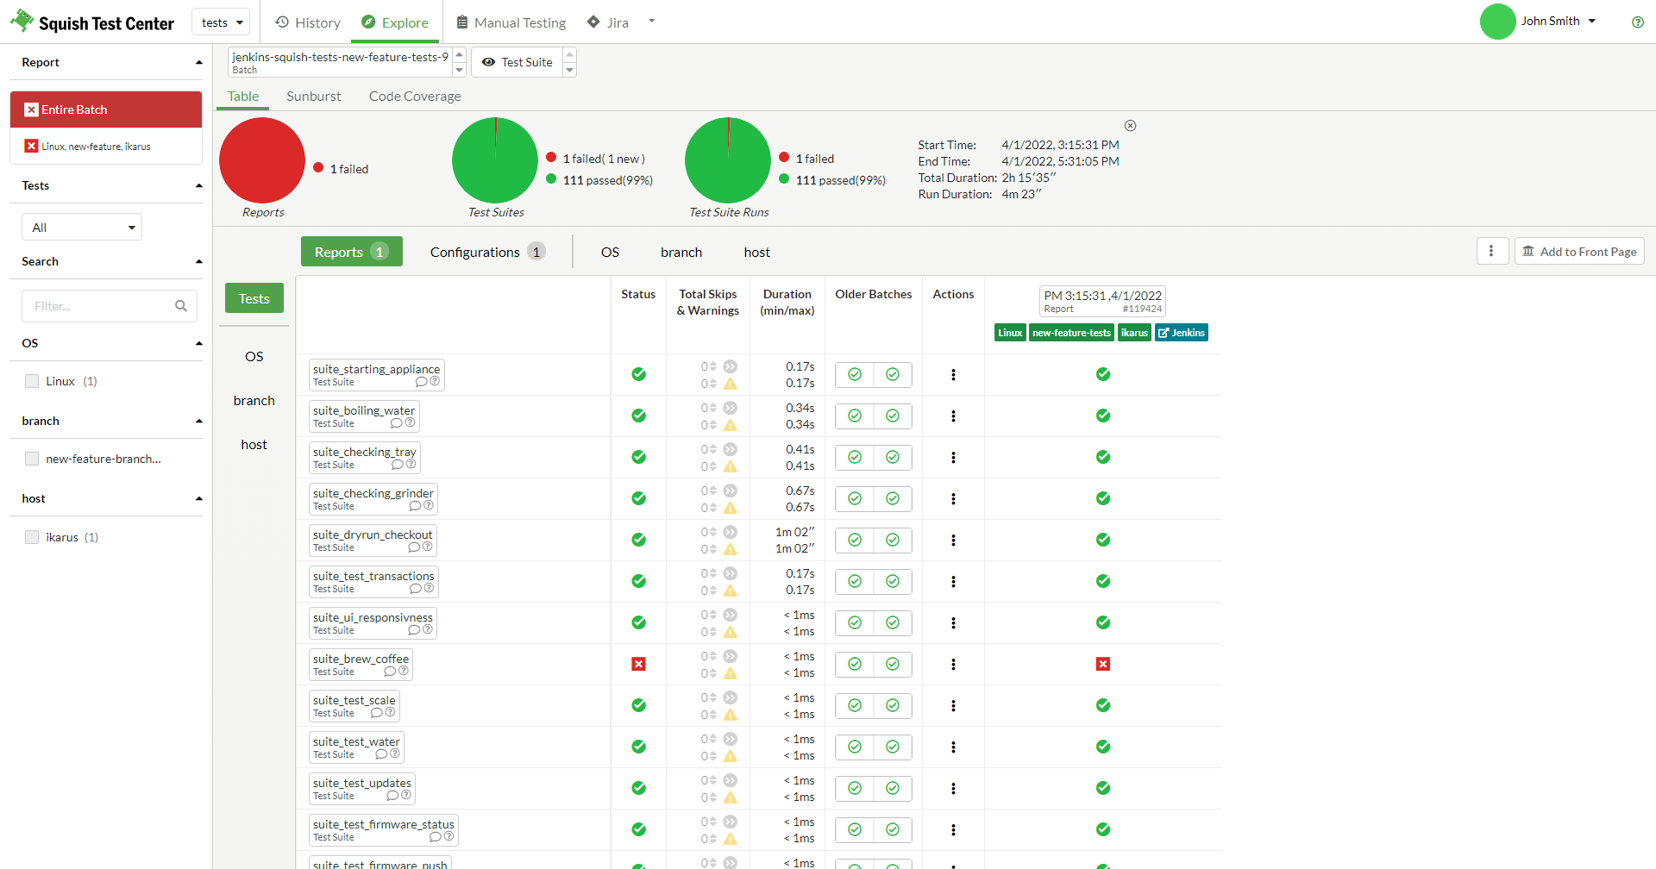
3.2
Overview of Test Center
Notes:
Todo: Add Screenshot of Test Center

Slide 42
Test Center Quick Features
QA Tools
1
Central dashboard for test results
2
Stream captured videos
3
Manage your tests from anywhere

Slide 43

Customers
QA Tools
Notes:
What customers to highlight and mention when passing this slide? With the States in mind, maybe: Disney, GE, Google, Pfizer and US Navy

Slide 44
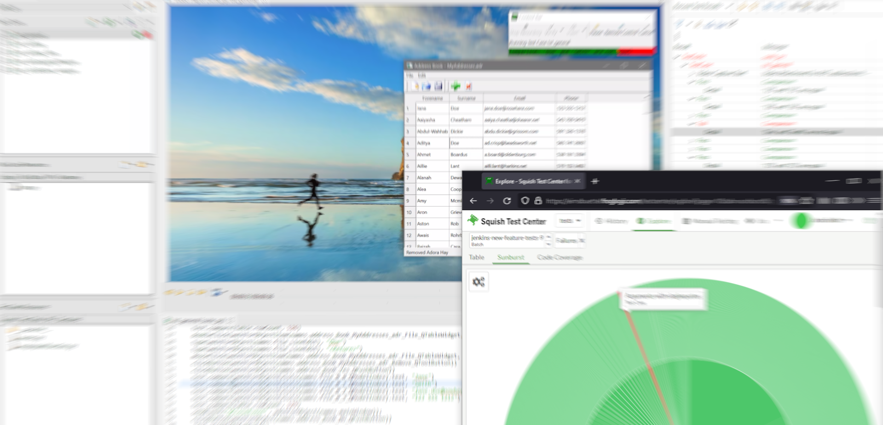
4
Wrap-up

Slide 45
Wrap-up
What the heck happened?
Record and Replay tests

Slide 46
Wrap-up
What the heck happened?
Record and Replay tests
Verifying values and screenshots

Slide 47
Wrap-up
What the heck happened?
Record and Replay tests
Verifying values and screenshots
How to break tests

Slide 48
Wrap-up
What the heck happened?
Record and Replay tests
Verifying values and screenshots
How to break tests
Different ways to approach failing tests

Slide 49
Wrap-up
What the heck happened?
Record and Replay tests
Verifying values and screenshots
How to break tests
Different ways to approach failing tests
Video is one piece in this puzzle

Slide 50
Wrap-up
What the heck happened?
Record and Replay tests
Verifying values and screenshots
How to break tests
Different ways to approach failing tests
Video is one piece in this puzzle
Develop tests with Squish

Slide 51
Wrap-up
What the heck happened?
Record and Replay tests
Verifying values and screenshots
How to break tests
Different ways to approach failing tests
Video is one piece in this puzzle
Develop tests with Squish
One way to automate manual testing

Slide 52
Wrap-up
What the heck happened?
Record and Replay tests
Verifying values and screenshots
How to break tests
Different ways to approach failing tests
Video is one piece in this puzzle
Develop tests with Squish
One way to automate manual testing
Manage test results with Test Center

Slide 53
Wrap-up
What the heck happened?
Record and Replay tests
Verifying values and screenshots
How to break tests
Different ways to approach failing tests
Video is one piece in this puzzle
Develop tests with Squish
One way to automate manual testing
Manage test results with Test Center
One way to handle the ever-growing number of test results

Slide 54
Wrap-up
What the heck happened?
Record and Replay tests
Verifying values and screenshots
How to break tests
Different ways to approach failing tests
Video is one piece in this puzzle
Develop tests with Squish
One way to automate manual testing
Manage test results with Test Center
One way to handle the ever-growing number of test results

Slide 55

Q&A
Let’s discuss your questions now!

Slide 56
Q&A
What the heck happened?
Further Q&A and open discussion
What pain points do you encounter when testing software?
How do you approach a failed test?
Do you have any preferred way of approaching?
Did you leverage video for debugging tests in the past?
What do you expect from a captured video?

Slide 57
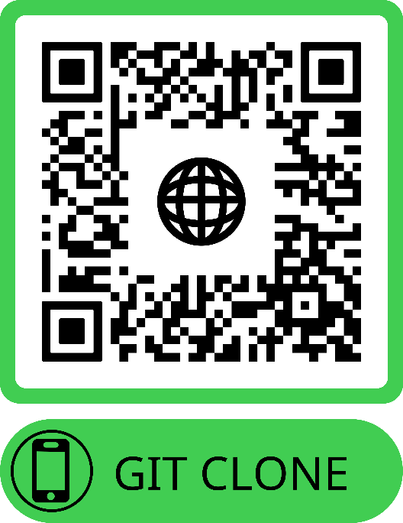
Thank you, let’s have a coffee and see you at our booth 21!
Demo Repository https://qrco.de/stareast-22-qt-demo
Jan Aarsaether jan.aarsaether@qt.io
Nick Kayes nick.kayes@qt.io
Thomas Piekarski thomas.piekarski@qt.io

Slide 58
Backup Slides

Slide 59
Thank you, all tests finished, see you at our booth 21!
Demo Repository https://qrco.de/stareast-22-qt-demo
Jan Aarsaether jan.aarsaether@qt.io
Nick Kayes nick.kayes@qt.io
Thomas Piekarski thomas.piekarski@qt.io

